Slide 1
AI for Rewriting & Content Enhancement
Dr.Esraa Ferwana

Slide 2
Using AI for Content Enhancement
Improve existing text instead of writing from scratch.
Rewrite sentences for better clarity and readability.
Adjust tone to suit different audiences.
Enhance grammar, style, and structure.
Make content more engaging and effective.

Slide 3
What can AI do in this area?
Rewrites text without changing the main meaning.
Simplifies difficult language.
Improves grammar and fluency.
Removes repetition and weak phrasing.
Adapts tone for different audiences.
Summarizes or expands content.
Suggests headings and structure.

Slide 4
Why is this Skill Important for AI Students?
AI students frequently create and manage different types of professional content, including:
Project descriptions
Technical reports
Professional emails
LinkedIn profiles and bios
GitHub README files
Research summaries
Presentation content

Slide 5
Paraphrasing: same meaning, different words.
Rephrasing: same idea, different sentence structure.
Rewriting: deeper change in wording, structure, and tone.
Enhancement: improving final quality, clarity, and impact.

Slide 6
How to Use AI Responsibly
make this paragraph more formal
simplify this explanation for beginners
shorten this email
improve clarity without changing meaning

Slide 7
How to use AI responsibly
Start with your own draft or original idea.
Tell the AI the exact goal: simplify, formalize, shorten, expand, or improve flow.
Review the result critically.
Compare original and revised versions.
Keep your meaning and technical accuracy.
Edit manually before final submission.

Slide 8
When AI Helps Most Content:
Editing a weak draft
Improving readability
Changing tone for a target audience
Rewriting technical ideas more clearly
Summarizing long content
Polishing presentations and reports

Slide 9
When Students Should Be Careful Content:
When the source meaning is complex
When references must be exact
When writing about technical results
When institutional AI rules are unclear
When the tool changes the meaning too much

Slide 10
Useful AI Tools
Grammarly – grammar, tone, and style improvement.
QuillBot – paraphrasing and rewriting support.
DeepL Write – clarity, phrasing, and tone refinement.
ChatGPT – rewriting, summarizing, and explanation support.

Slide 11
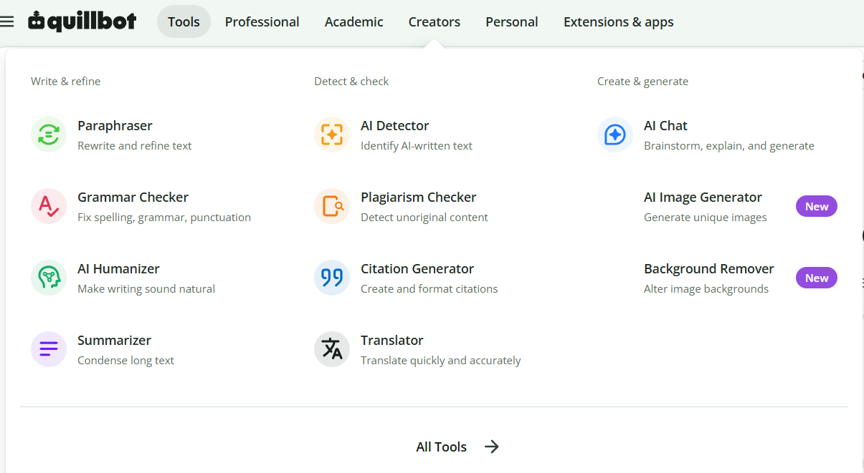

Slide 12
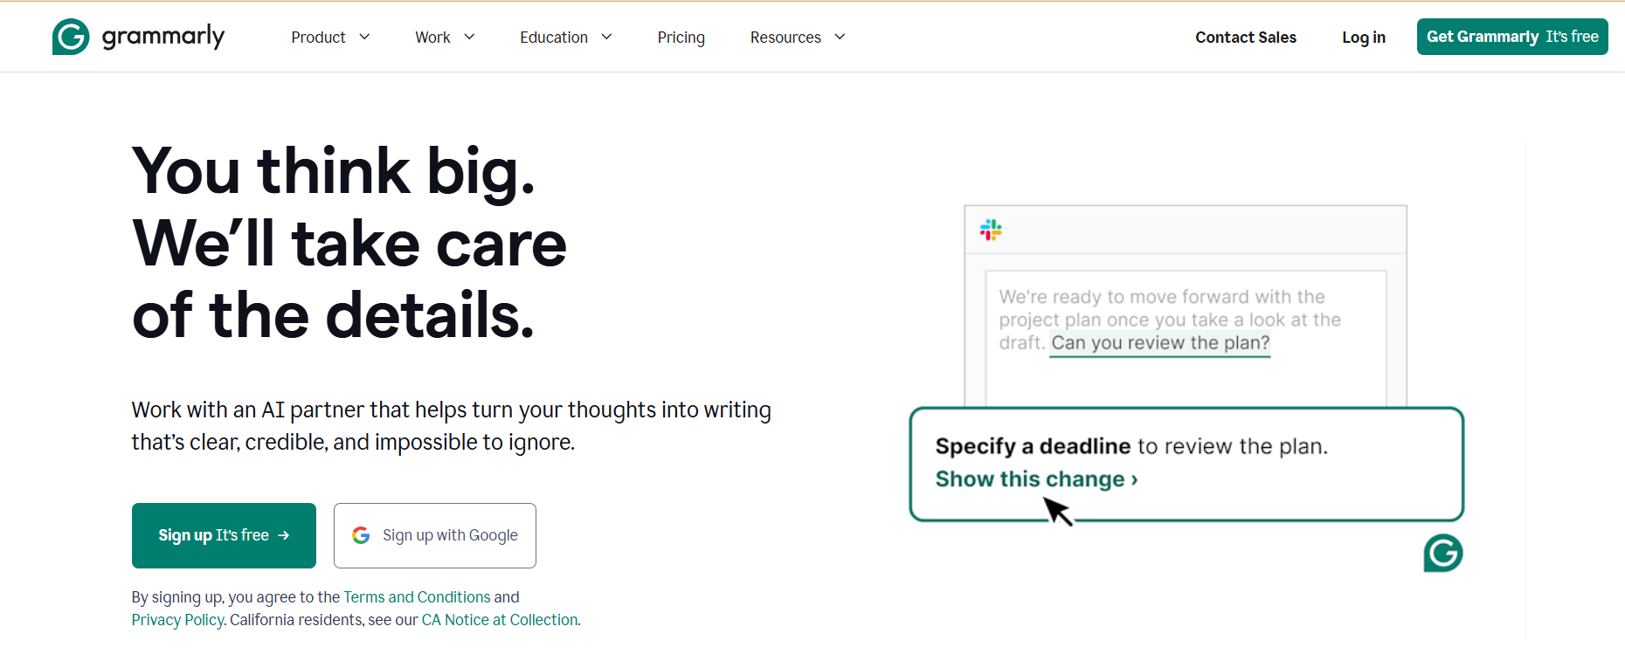

Slide 13
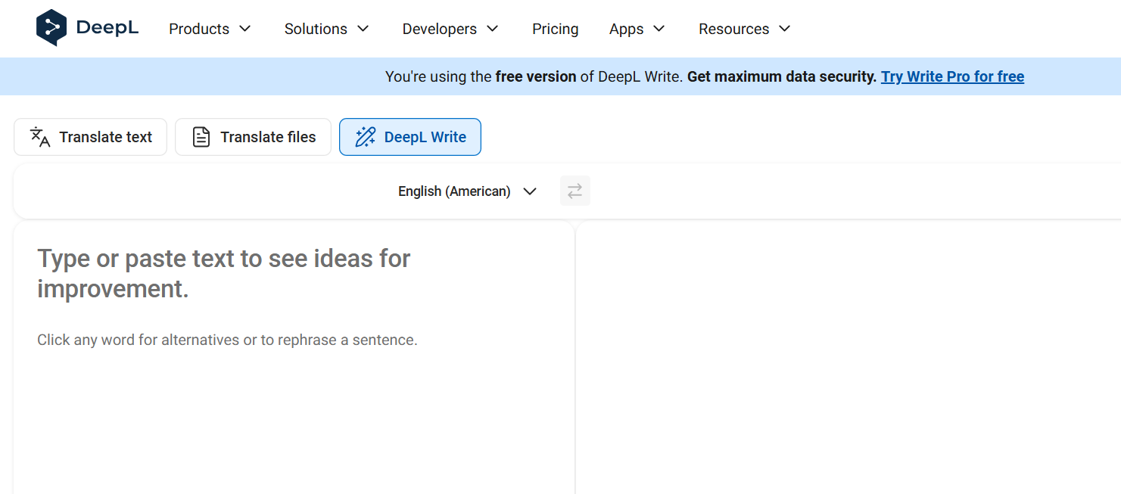

Slide 14
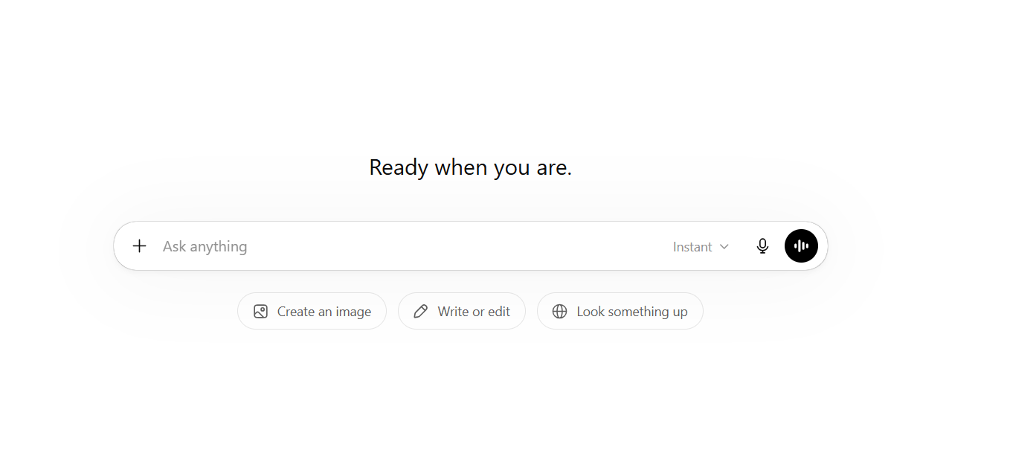

Slide 15
Risks and Ethical Use
AI may produce vague or inaccurate text.
Overreliance on AI can weaken critical thinking.
Always verify facts and technical meaning.
Avoid plagiarism and follow academic integrity rules

